Slide 1
Harmony in Existence vfLrRo esa O;oLFkk

Slide 2
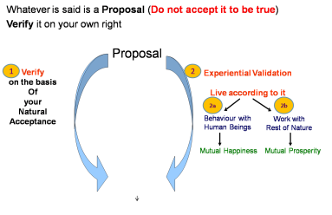
Self-exploration, Self-investigation, Self-study
1. Content of Self Exploration:
  a. Desire (pkguk) - Aim, Purpose
  b. Program (djuk) – Process of achieving the desire, action
Happiness = To be in Harmony
2. Process of Self Exploration
Self-verification
– Happiness, Prosperity → Continuity
To understand Harmony & to live in harmony at all 4 levels:
  Harmony in the Human Being
  Harmony in the Family
  Harmony in the Society
  Harmony in Nature/Existence

Slide 3
Harmony in Existence vfLrRo esa O;oLFkk
vfLrRo ¾ vfLr + + Ro
↓ ↓
gS@gksuk O;oLFkk
Existence = Exist + Essence, whatever exists
↓ ↓
to be harmony
vfLrRo ¾ lg&vfLrRo ¾ O;kid esa lai`Dr bdkb;ka
Existence = Co- Existence = Units submerged in Space

Slide 4
Harmony in Existence (vfLrRo esa O;oLFkk)
Existence = Co- Existence = Units submerged in Space
vfLrRo ¾ lg&vfLrRo ¾ 'kwU; esa lai`Dr bdkb;ka
Material
tM+
Consciousness
pSrU;

Slide 5
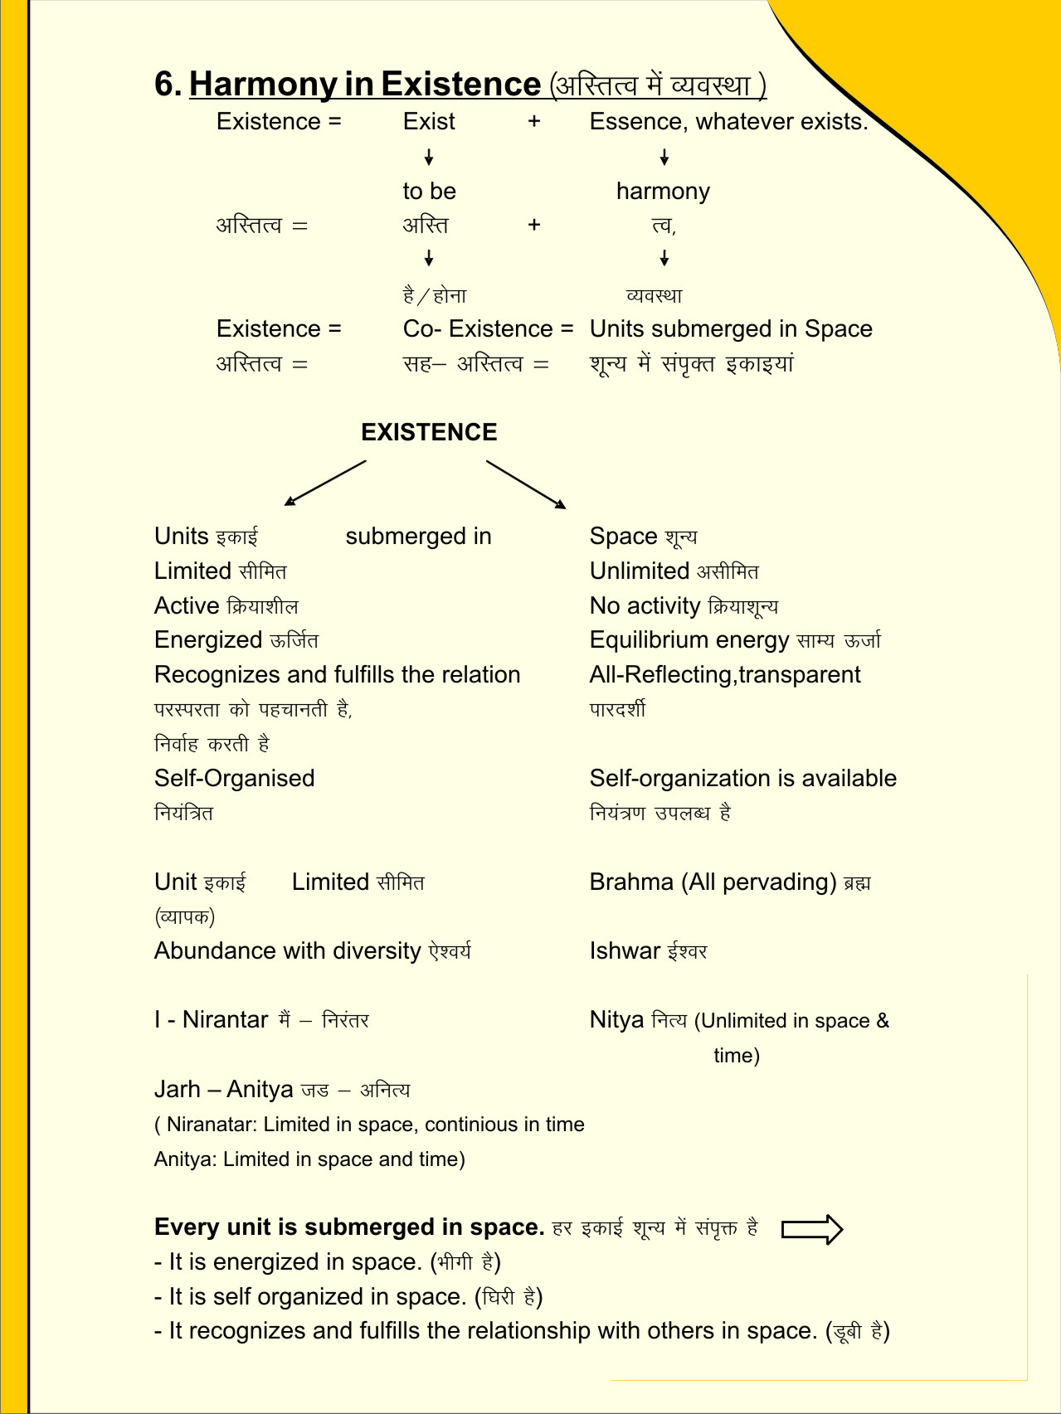
Harmony in Existence vfLrRo esa O;oLFkk
vfLrRo
¾ lg&vfLrRo Co-existence
O;kid (All Pervading)
lai`Dr
vkdkj
¼“kwU;½
Lo;a esa OoLFkk gSA
] lÙkk
ijLijrk dks igpkurh gS] fuokZg djrh gS
tkuuk] ekuuk] igpkuuk] fuokZg djuk pSrU; esa
Kku ¼psruk½
cMh OoLFkk esa Hkkxhnkj gSA lexz OoLFkk esa Hkkxhnkj gSA

Slide 6
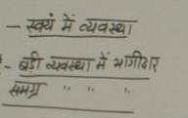
Harmony in Existence (vfLrRo esa O;oLFkk)
vfLrRo
lai`Dr
vkdkj

Slide 7
Harmony in Existence vfLrRo esa O;oLFkk
Existence vfLrRo =
Units Submerged in Space
bdkb;ka lai`Dr O;kid (All Pervading)
Limited in Size lhfer vkdkj Unlimited vlhfer
Activity, Active fØ;k] fØ;k'khy No Activity fØ;k'kwU; ¼'kwU;½
  Energised (ÅftZr) in Space
  Self Organised (fu;af=r] Lo;a esa O;oLFkk gS) in Space
  Recognises it's relationship & Fulfills
  it with every other Unit in Space
  (ijLijrk dks igpkurh gS] fuokZg djrh gS
  cM+h O;oLFkk esa Hkkxhnkj gS] lexz O;oLFkk esa Hkkxhnkj gS)
CO-EXISTENCE
lg&vfLrRo

Slide 8
Harmony in Existence
Self – is an activity, integrated (not divisible), energised, self-organised, recognises other units (e.g. body) & participates in larger order (eg. human being)
Human Being – is an activity, integrated (not divisible), energised, self-organised, recognises other units (e.g. other human beings, rest of nature) & participates in larger order (eg. family)
Family – is an activity, integrated (not divisible), energised, self-organised, recognises other units (e.g. other families, society, rest of nature) & participates in larger order (eg. Education-sanskar dimension of society, work with rest of nature)
Society (all human beings) – is an activity, integrated (not divisible), energised, self-organised, recognises other units (e.g. rest of nature) & participates in larger order (eg. tradition)
Nature – is an activity, integrated (not divisible), energised, self-organised, recognises other units (e.g. existence) & participates in larger order (eg. Earth rotates on its axis and revolves around the Sun)

Slide 9
Niyantrit hai ➔
Swayam, main vyavastha hai – ek nischit vyavastha mein bana hua hai
Badi vyavastha main bhagidaar hai
Samagr vyavastha main bhagidaar hai

Slide 10
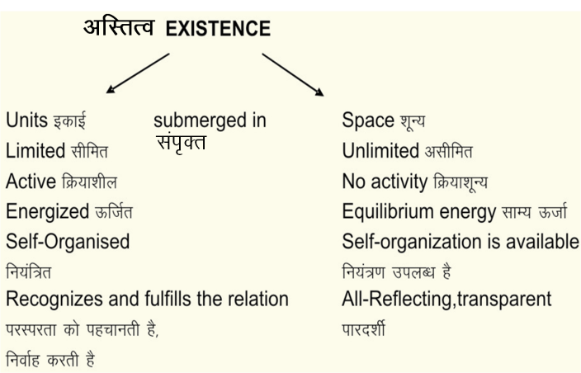
Harmony in Existence (vfLrRo esa O;oLFkk)
Material
tM
Consciousness
pSrU;

Slide 11
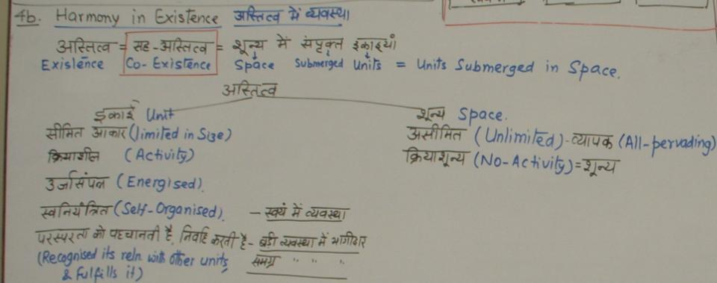

Slide 12
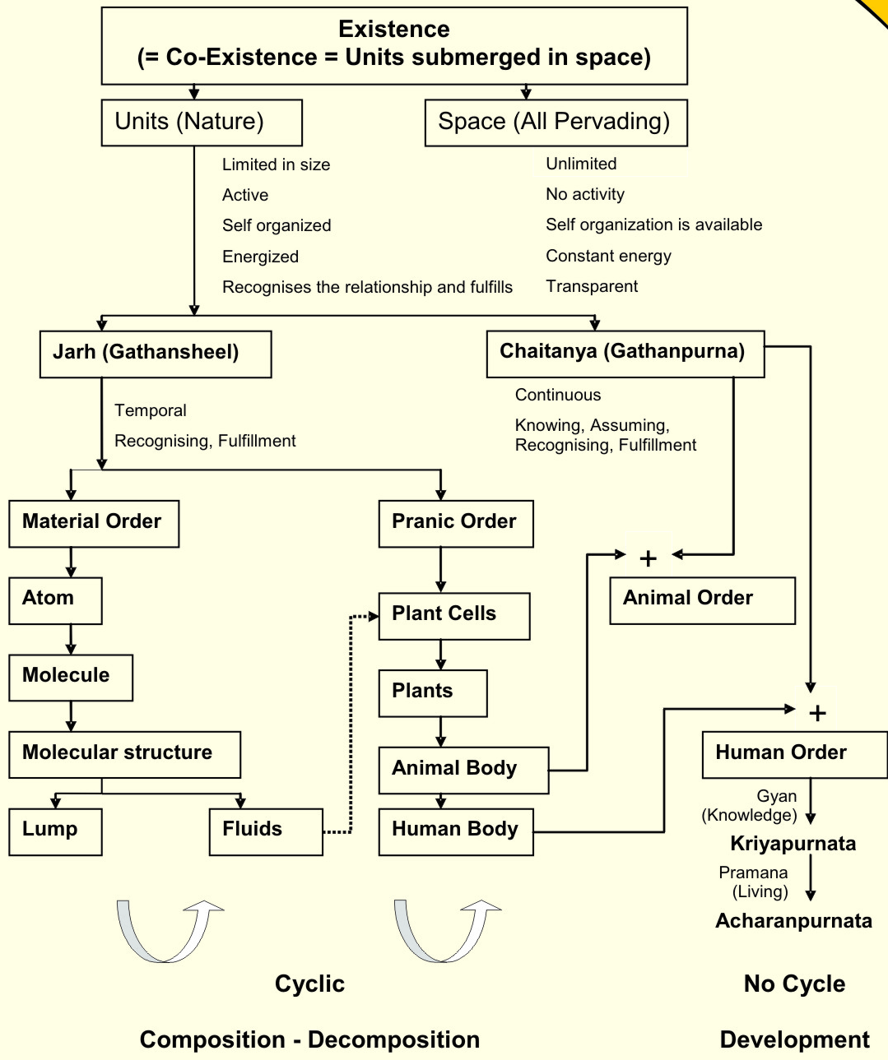

Slide 13
Sum Up
Existence is in the form of co-existence. It is ever present
(Existence = Co- Existence = Units submerged in Space)
Every unit in existence is related with every other unit in existence in a mutually fulfilling manner
Synergy is intrinsic to existence, harmony is inherent in existence – we do not have to create it, we do not have to construct it
The role of Human Being is to realize this co-existence, this harmony, this order in existence – For this, all that human beings need to do is:
  To understand the inherent harmony, the co-existence in existence
  To live accordingly – to live with the feeling of harmony or co-existence (and there is every provision in existence for living in co-existence)

Slide 14
So we can go back and ask ourselves once again…
Is Nature/Existence self organized or is it a chaos?
Is struggle inherent in Nature/Existence?
Is there survival of the fittest in Nature/Existence?
Have we understood our self?
Have we recognised our needs correctly?
Have we recognised our goal as a human being; as a society correctly?
Or have we assumed it to be something other than what it really is? And we are living with some wrong assumptions!
The answers are within ourselves… All we need to do is to make the effort to understand…

Slide 15
Program for Human Being (Our Role in Existence)
Existence is Co-existence
Human Being is by virtue of Co-existence; embedded in Co-existence
All the Human Being needs to do is to to understand Co-existence and to live in Co-existence

Slide 16
Program for Human Being (Our Role in Existence)
Human beings have two important things to do:
1. To understand the co-existence
  1.1. To understand co-existence – Knowledge (Gyan)
  1.2. To ensure the feeling, thought of co-existence –
Resolution (Samadhan)
2. To live in co-existence
  2.1. To live in relationship with human-beings
  –family to world family – Undivided Society
  (Akhand Samaj)
  2.2. To live in co-existence in nature
  –family order to world family order – Universal Human Order (Sarvbhaum Vyavastha)
  By these two being ensured by human beings, the result will be Undivided Society and Universal Human Order on Earth, in which Harmony and peace are very natural outcomes (and there is every provision in Existence for it)

Slide 17
Now we can see that…
Happiness is an indicator, a feedback, that we
have understood harmony and
live in harmony
Unhappiness is an indicator, a feedback, that we
have not understood harmony and/or
do not live in harmony
Our role is to make the effort
to understand harmony and
to live in harmony
This is our role in existence …
at all 4 levels of our being
at one or more of the 4 levels of our being
at all 4 levels of our being
  In the Self, as an Individual
  In Family
  In Society
  In Nature/Existence

Slide 18
Our Role in Existence – 1. Realisation of Co-existence (WITHIN)
Space “kwU;
Natural Acceptance
lgt LohÑfr
 | Force / Power cy@“kfDr | Activity fØz;k
1. |  | Realization vuqHko | Co-existence lg&vfLrRo
2. |  | Understanding cks/k | Harmony in Nature O;oLFkk
3. | Desire bPNk | Imaging fp=.k | Participation in Larger Order O;oLFkk esa Ekxhnkjh
4. | Thought fopkj | Analysing fo'ys"k.k
5. | Expectation vk'kk | Selecting/Tasting p;u@vkLoknu
Self (I)
eSa
Contemplation
fparu
Body 'kjhj
Behaviour O;ogkj
Human ekuo
Work dk;Z
Rest of Nature
euq";sÙkj iz—fr
Participation Òkxhnkjh
in larger Order O;oLFkk esa
Other nwljk

Slide 19
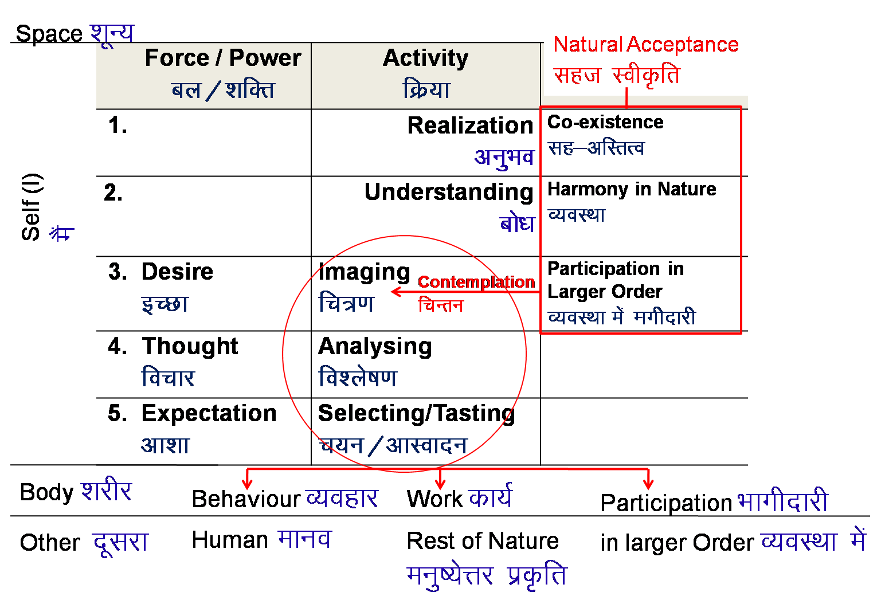
Our Role in Existence – 2. Universal Human Order (EXPRESSION)
Human Tradition
ekuoh; ijaijk
Mutual Happiness
mHk; lq[k
Mutual Prosperity
mHk; le`f)
Fulfillment of Human Goal
Ekuo y{; dh iwrhZ
Undivided Human Society
v[k.M ekuoh; lekt
Universal Human Order
lkoZHkkSe ekuoh; O;oLFkk

Slide 20
Our role in existence is to recognize human target, and ensure it…
Human Target
Human Target (ekuo y{;)
… by participating in one or more dimensions of human order…. Starting from family order to world family order
Right Understanding & Right Feelings
Prosperity
Fearlessness
(Trust)
Co-Existence
In Every Individual
In Every Family
In Society
In Nature/ Existence
Knowledge &
Resolution (All Encompassing Solution) through Self Exploration
Right Production based on
Labour
Avartansheel Process
Relationship, Justice
From Family to World Family
Harmony, Natural Laws
From Family Order to World Family Order
Happiness
Prosperity
Undivided Society
Universal Human Order

Slide 21
Gist
Lrj fLFkfr xfr .
vfLrRo lg& vfLrRo lkoZHkkSe O;oLFkk
Ekkuo vuqHko izek.k
ijLijrk esa izse] d:.kk v[k.M lekt
Level State Expression .
Existence Co-existence Universal Human Order
Human Being Realisation Evidence, Authentication
In Mutual relationship Love, Compassion Undivided Society

Slide 22
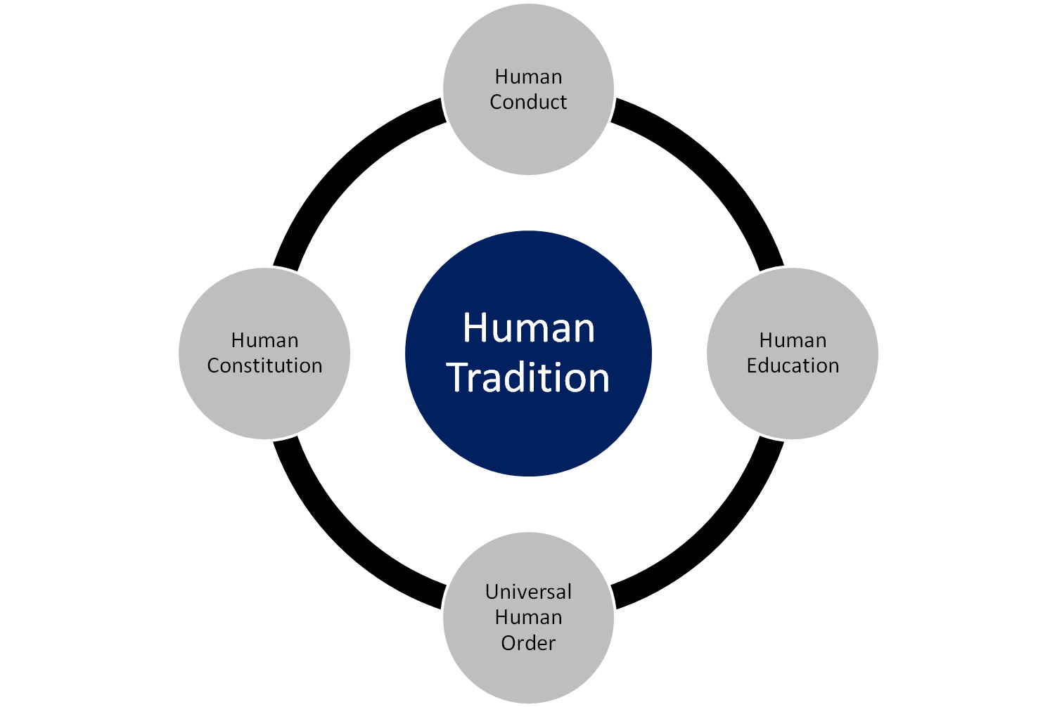
Universal Human Order: Dynamics
Conduct that ensures
continuity of mutual
happiness &
prosperity
Education that
ensures the
development of the
competence to live
with
Definite
Human
Conduct
Nature of
society
of people living
together in a
relationship of
mutual fulfillment
Entry Point
The society in which
Human Goal
is realised

